Slide 1
Welcome to Klaipeda! Summer School program 16 August – 31 August, 2017 GLOBAL CHALLENGES FROM LOCAL PERSPECTIVE

Slide 2
Dear Partners,
We are glad to invite you to our 1st International Student Summer School: Global Challenges from the Local perspective, which will take place for the first time on August 16–31, 2017.
The summer school will consist of lectures, training sessions, workshops and visits to various organizations.
The participants will receive a course package with all course information and reading materials, including articles and datasets prior to the Course.
Course language – English.

Slide 3
Content:
1. MODULES
2. HOST SITE: KLAIPEDA UNIVERSITY
3. SUMMER SCHOOL VENUE AND PROPOSED DATES
4. APPLICATION PROCESS
5. ACCOMMODATION IN KLAIPEDA
5. ARRIVAL TO KLAIPEDA
6. KLAIPEDA
7. MAP OF KLAIPEDA’S CENTER

Slide 4
Modules:
Social Policy in Europe. The course examines social dimension of the EU integration, the content, structures, trends and main priorities of social policies. The course analyses legal documents regulating the EU social policy and opportunities of their realisation. It also explores social policy models of the EU member states, the features of the types of countries and their harmonization. The course examines the employment policy, principles and means of unemployment protection, problems of deprivation and poverty reduction, gender equality and women’s social rights guarantees, features of such rights, social welfare and social insurance principles, policies for elderly and programmes of social integration of disabled people in the EU.
Factors of Attractiveness for International Tourism Development in the Curonian Lagoon Region: a comparative analysis of the processes relating to the development of international tourism in Lithuania in the context of the Baltic States.

Slide 5
Modules:
Corruption and Prevention. The main aim is to develop expertise in a broad, creative and critical thinking, the need for new interest in preventing corruption in the achievements of global trends. The course analyses:
Local government between state and market
Corruption prevention in Local Government
Public procurement
Public-private interests
Fields of risk in the local government
Risks of the financial crimes in Local Government and links to the corruption
Local government activity, limits of the responsibility, service delivery
Fields of risk in the local government
Risks in the field of public services delivery
Responsibility in the field of finance crimes

Slide 6
Modules:
Cluster Development Workshop. This workshop will introduce the process of cluster development and equip participants with the necessary skills to nurture their business ideas jointly. Participants will gain the skills and confidence needed to:
Identify and prioritize their region’s businesses and create added value within the initiative of cluster.
Implement an interactive, collaborative strategy development process by involving key leaders from business, government, education and civic life.
Mobilize business participants in the implementation of action initiatives that directly address regional competitiveness challenges.
The goal of this Cluster Development Workshop is to provide the right for these students jointly to work in teams and develop the business idea in order to enhance their idea competitiveness and establish a dynamic work in teams to get tools to achieve these objectives.

Slide 7
Modules:
With all this baggage accumulated workshop result it will be provided a comprehensive and very specific knowledge of how to work with different companies and ideas in the cluster (companies, institutions and administration), how to create added value with proposed business idea, how to develop initiatives to strengthen the competitiveness, identifying and map the clusters in a territory and its management.
Thematic topics include:
Drivers of competitiveness – why, how and when businesses compete?
The Diamond model – is it shining as diamond?
Cluster – what kind of company we are talking about?
Stages of development – what leads to progress/regress?
Roles of different levels of government – are we making business along with government?
Economic strategy – how to make this strategy really alive?

Slide 8
Modules:
Cultural differences: understanding cultural differences; how cultural differences affect business; consequences of cultural differences: stereotypes and prejudices.
Crash course of Lithuanian: The beginners will acquire basic skills of spoken and written Lithuanian (conversation skills, shopping, travelling, etc.)
The programme of the Summer School will be complemented with lectures and seminars of teachers from Partner Universities as well.

Slide 9
Host side: Klaipeda University
Klaipeda University was established in 1991. It celebrated its 25th anniversary with 4,500 students in the Faculties of Marine Engineering and Natural Sciences, Humanities and Education Sciences, Social Sciences and Health Sciences, as well as in the Arts Academy, the Institute of Continuous Studies, and the Institute of Baltic Region History and Archaeology. Over the 25 years, the academic staff of the University has increased from 300 to nearly 700 teachers and researchers, including 59% PhDs and/or recognised artists.
Currently, the University implements over 100 study programmes in all three cycles, providing research and technological innovations-based contemporary knowledge which ensures advanced university education and high professional skills and develops an intelligent, responsible, and creative personality. Our Alma Mater has over 30,600 graduates whose ranks include PhDs, members of the Seimas and the Government, heads of major enterprises, engineers, teachers, soloists, and theatre professionals.
Over 60 research and training labs, a botanical garden, a research vessel Mintis, a research and training sailboat Brabander, the yacht Odisėja, an Open Access Centre for Marine Research, a training theatre, a concert hall with excellent acoustics and the Rieger Kloss organ, an Ecumenical Evangelical Chapel, library document funds with almost 500,000 copies, and a publishing house provide for an important infrastructure that enables the successful development of the international level artistic activities, fundamental and applied scientific research, experimental development activities in the fields of physical, biomedical, technological, social sciences, and the humanities.
The University annually implements over 60 international and national research projects, collaborates with research and academic partners in Europe and other parts of the world, and takes part in the activities of international funds, programmes, and networks.
The university campus is located in the territory of 24 hectares.
It consists of Klaipeda region traditional architectural buildings and modern buildings.

Slide 10
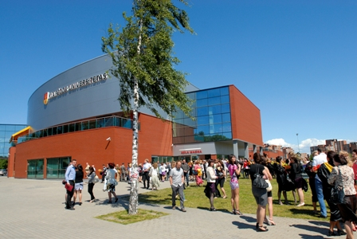
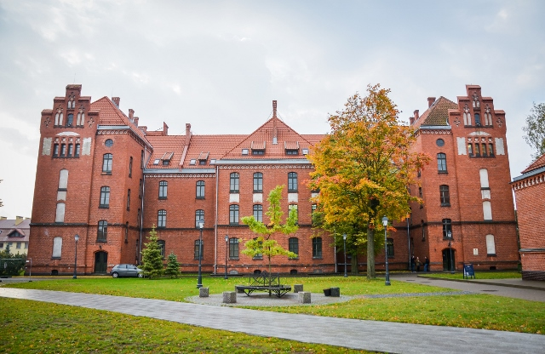
Host side: Klaipeda University
Socio-economic circumstances formed rapid development needs for Klaipeda University. The University is located in the part of Lithuania with a population of over 470 thousand residents where industrial and business potential is significant, maritime sector is rapidly developing. Klaipeda University was established in a specific coastal area of Lithuania from economic, cultural and geopolitical point of view, in the only port city where from Lithuania opens wide prospects for maintaining relations with the Baltic Sea countries and other parts of the world.
Klaipeda University is located in the city which in the general plan of the Republic of Lithuania is described as the state-wide metropolitan Centre. It is provided with special supportive measures that determine the development of the port, economic and recreational agglomeration on a competitive European level, institutional realization of the country’s marine orientation, strengthening the existing scientific and research potential.

Slide 11
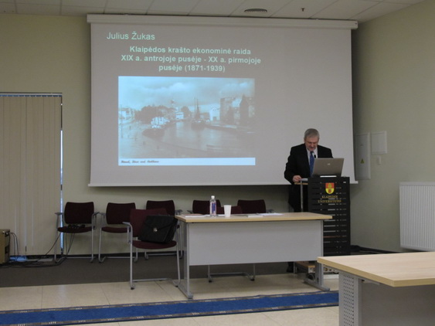
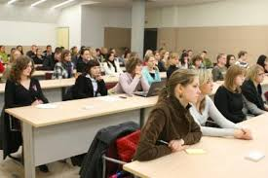
Summer School Venue and Proposed Dates
16–31 August, 2017
Summer school will take place at Klaipeda University campus, Aula Magna building.
Adress: H.Manto 84, Studlendas, AULA MAGNA, Klaipėda
All campus buildings have free Wi-Fi connection.

Slide 12
Application process
Fill in the online APPLICATION FORM till the 15th of June, 2017.
Send 1 page Motivation Letter and a copy of your passport* to erika.zuperkiene@ku.lt.
You may be asked to confirm your participation by paying relevant fees in 2 weeks’ time after your registration.
All the information about your application along with the admission decision will be sent to you by the 30th of June, 2017.
* Please note that we need to have all the required documentation before the 15th of June, 2017.

Slide 13
Fees and Deadlines
The Summer School „Global Challenges from the Local Perspective“ fees per participant:
Registration fee – 30 EUR;
Fee for students from partner institutions – 250 EUR;
Regular fee – 450 EUR.
Registration fee deadline is the 15th of June, 2017; final payment deadline is the 15th of July, 2017.
_______________________________________________________________
The Course fee includes tuition, all Course materials and cultural programme. Cultural programme will include some lectures, tours around Klaipeda and some sites out of town. Participants are expected to cover the costs of travel, living and accommodation themselves.

Slide 14
Accommodation in Klaipeda
More than 20 hotels, 11 guests’ houses and 3 hostels are carrying business in Klaipeda. Klaipeda University can make special offers of some Hotel prices.
Our proposal would be:
Dormetory.
Promenada Hotel located in 5 min walk to Klaipeda University and 15 min walk Klaipeda Old Town. For more information please visit website http://promenada.lt/
Navalis Hotel located in 15 min walk to Klaipeda University and 10 min walk to Klaipeda Old Town. For more information please visit website http://www.navalis.lt/en.php
Amberton Hotel located in 25 min walk to Klaipeda University and 5 min walk to Klaipeda Old Town. For more information please visit website http://ambertonhotels.com/en/klaipeda/

Slide 15
Klaipeda City is situated alongside the Baltic Sea, on beautiful west coast of the Republic of Lithuania. It is possible to arrive to the city by sea, land and air connections.
Arrival to Klaipeda
BY CAR | BY BUS | BY TRAIN | BY FERRY | PLEASURE BOAT | BY CRUISE SHIP | BY AIR
Distance between Klaipeda and capital city Vilnius is 330 km. A highway system ensures speedy travel for all car drivers. | Klaipeda Bus station is situated 15 minutes’ walk from the centre of the town. www.klap.lt www.eurolines.lt | Klaipeda Train station is situated next to Bus station, only 15 minutes’ walk from the centre of the town. www.litrail.lt | International ferry terminal is situated 18 km away from the city centre or within 45 minutes’ drive by car. Regular ferry lines: Klaipėda–Kiel (Germany), Klaipėda–Karlshamn (Sweden) www.lisco.lt | A modern yacht and pleasure craft port (also called – Castle Harbour) is an unique place in the centre of the town where the boats are safe from waves and wind. www.ports.lt | Cruise ship terminal is situated 800 meters from the city centre or within approximately 8−10 minutes walking distance. www.portofklaipeda.lt | Palanga International Airport is situated 25 km away from Klaipeda City. Car rental and taxi services available. www.palanga-airport.lt

Slide 16
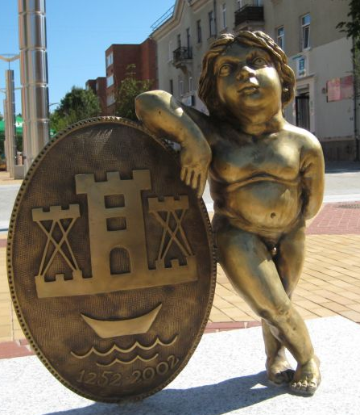
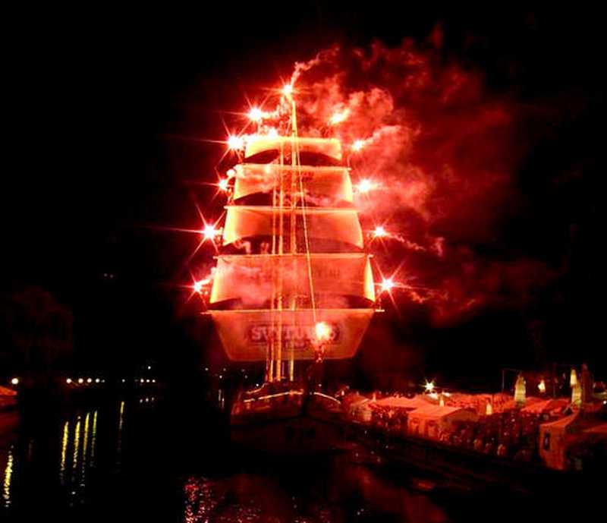
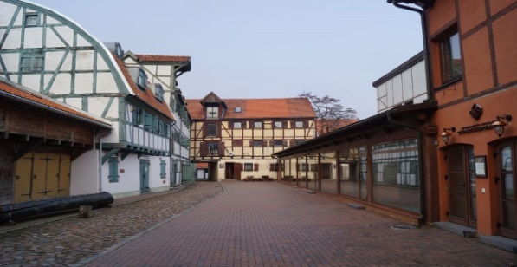
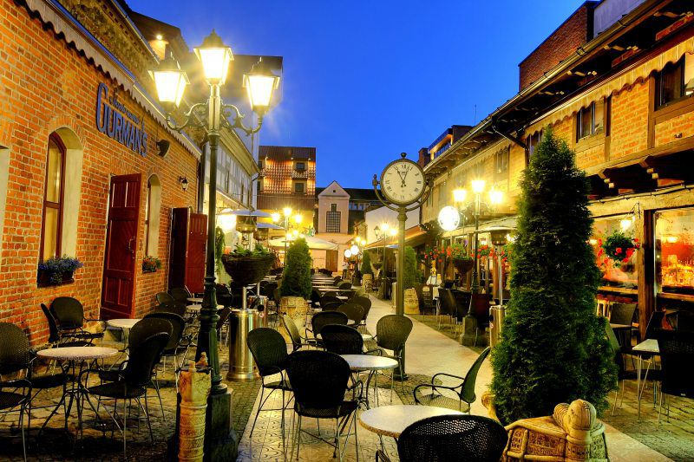
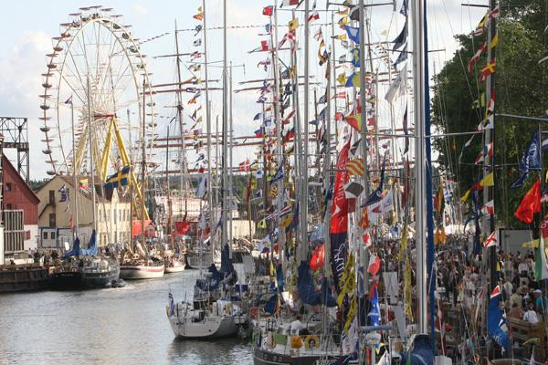
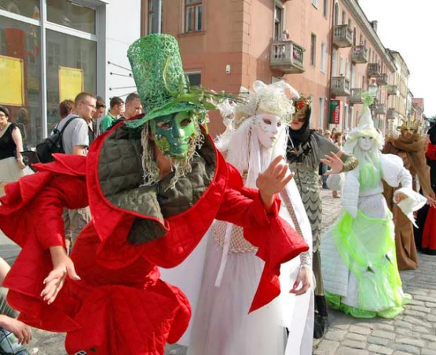
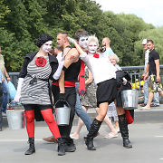
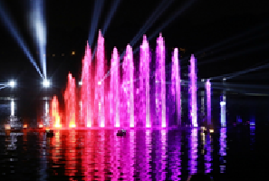
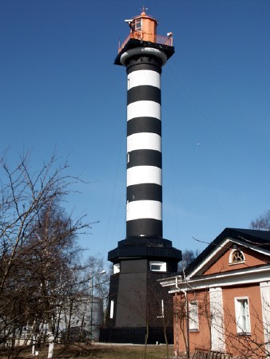
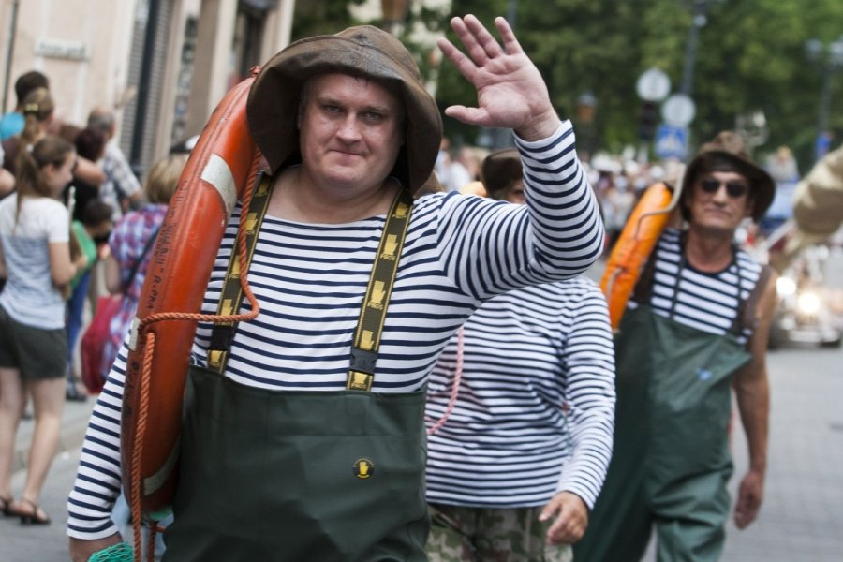
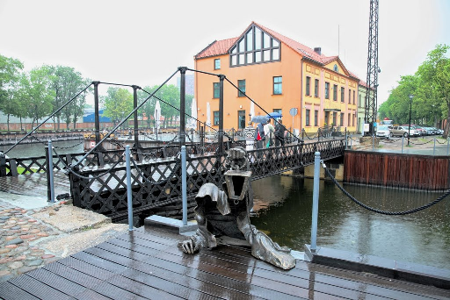
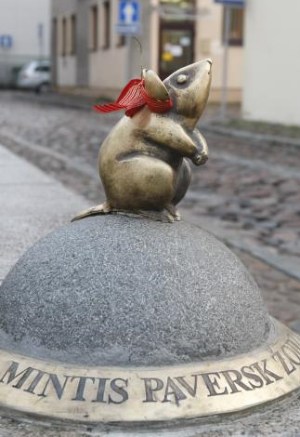
Klaipeda

Slide 17
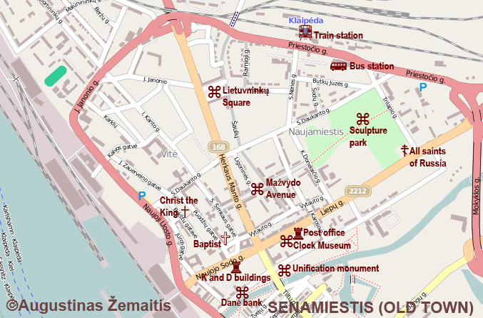
Map of Klaipeda’s Centre

